Slide 1
Exception-Handling
Prepared using following Resources:
Herbert Schildt, “Java: The Complete Reference”, Tata McGrawHill Education
E Balagurusamy, Programming with Java - A Tata McGraw Hill Education
https://www.geeksforgeeks.org/java/
https://www.javatpoint.com/java-tutorial
https://www.tutorialspoint.com/java/index.htm
https://www.w3schools.com/java/
By: DIVAKARA .N

Slide 2
Basics
Different types of exception classes
Use of try & catch with throw
throws & finally
Creation of user defined exception classes

Slide 3
  Basics:
The three categories of errors
Syntax errors arise because the rules of the language have not been followed. They are detected by the compiler.
Runtime errors occur while the program is running if the environment detects an operation that is impossible to carry out.
Logic errors occur when a program doesn't perform the way it was intended to.

Slide 4
  Basics: ...
An exception is an abnormal condition that arises in a code sequence at run time. In other words, an exception is a run-time error.
In computer languages that do not support exception handling, errors must be checked and handled manually - typically through the use of error codes, and so on.
A Java exception is an object that describes an exceptional (that is, error) condition that has occurred in a piece of code. When an exceptional condition arises, an object representing that exception is created and thrown in the method that caused the error.

Slide 5
  Basics: ...
Exceptions can be generated by the Java run-time system, or they can be manually generated by our code.
Exceptions thrown by Java relate to fundamental errors that violate the rules of the Java language or the constraints of the Java execution environment.
Manually generated exceptions are typically used to report some error condition to the caller of a method.
Java exception handling is managed via five keywords: try, catch, throw, throws, and finally.

Slide 6
  Basics: ...
Program statements that you want to monitor for exceptions are contained within a try block. If an exception occurs within the try block, it is thrown. Our code can catch this exception (using catch) and handle it in some rational manner.
System-generated exceptions are automatically thrown by the Java run-time system. To manually throw an exception, use the keyword throw. Any exception that is thrown out of a method must be specified as such by a throws clause. Any code that absolutely must be executed after a try block completes is put in a finally block.

Slide 7
  Basics: ...
The general form of an exception-handling block:
try {
  // block of code to monitor for errors
  }
    catch (ExceptionType1 exOb) {
    // exception handler for ExceptionType1
    }
    catch (ExceptionType2 exOb) {
    // exception handler for ExceptionType2
    }
    // ...
    finally {
    // block of code to be executed after try block ends
    }

Slide 8
  Exception Types:
All exception types are subclasses of the built-in class Throwable. Thus, Throwable is at the top of the exception class hierarchy. Immediately below Throwable are two subclasses that partition exceptions into two distinct branches.
One branch is headed by Exception. This class is used for exceptional conditions that user programs should catch. This is also the class that you will subclass to create our own custom exception types. There is an important subclass of Exception, called RuntimeException. Exceptions of this type are automatically defined for the programs that you write and include things such as division by zero and invalid array indexing.

Slide 9
  Exception Types: ...
The other branch is topped by Error, which defines exceptions that are not expected to be caught under normal circumstances by our program. Exceptions of type Error are used by the Java run-time system to indicate errors having to do with the run-time environment, itself. Stack overflow is an example of such an error.
This chapter will not be dealing with exceptions of type Error, because these are typically created in response to catastrophic failures that cannot usually be handled by our program.

Slide 10
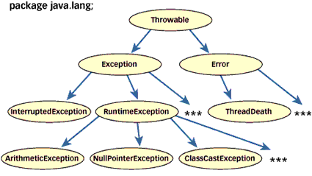
  Exception Types: ...
  Every Exception type is basically an object belonging to class Exception
  Throwable class is the root class of Exceptions.
  Throwable class has two direct subclasses named Exception, Error

Slide 11
  Exception Types: ...
  Checked Exceptions
  All Exceptions that extends the Exception or any one its subclass except RunTimeException class are checked exceptions.
Checked Exceptions are checked by the Java compiler.
There are two approaches that a user can follow to deal with checked exceptions.
  Inform the compiler that a method can throw an Exception.
  Catch the checked exception in try catch block.

Slide 12
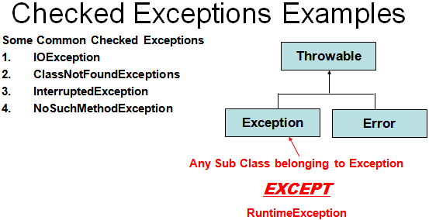
  Exception Types: ...
  Checked Exceptions…
If Checked exception is caught then exception handling code will be executed and program’s execution continues.
If Checked exception is not caught then java interpreter will provide the default handler. But in this case execution of the program will be stopped by displaying the name of the exceptions object.

Slide 13
  Exception Types: ...
  Unchecked Exceptions
  All Exceptions that extend the RuntimeException or any one of its subclass are unchecked exceptions.
Unchecked Exceptions are unchecked by compiler.
Whether you catch the exception or not compiler will pass the compilation process.
If Unchecked exception is caught then exception handling code will be executed and program’s execution continues.
If Unchecked exception is not caught then java interpreter will provide the default handler. But in this case execution of the program will be stopped by displaying the name of the exceptions object.

Slide 14
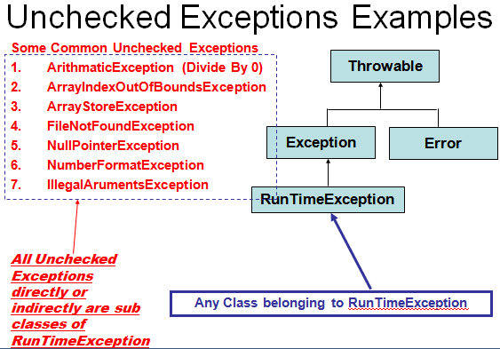
  Exception Types: ...
  Unchecked Exceptions…

Slide 15
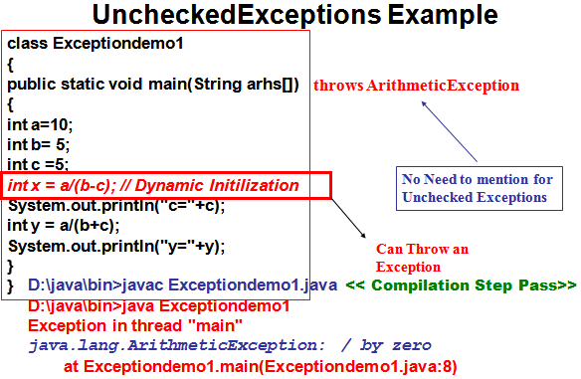
  Exception Types: ...
  Unchecked Exceptions…

Slide 16
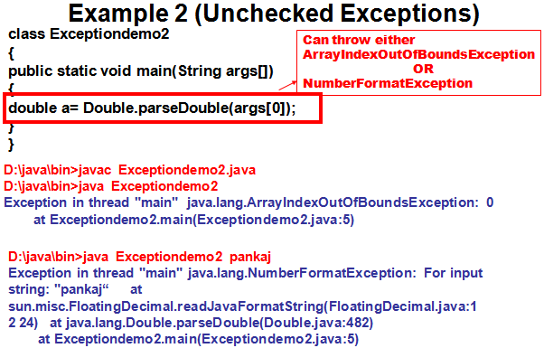
  Exception Types: ...
  Unchecked Exceptions…

Slide 17
  Exception Types: ...
  Checked Exceptions vs. Unchecked Exceptions
  RuntimeException, Error and their subclasses are known as unchecked exceptions.
  All other exceptions are known as checked exceptions, meaning that the compiler forces the programmer to check and deal with the exceptions.

Slide 18
  Exception Types: ...
  Checked Exceptions vs. Unchecked Exceptions…
  Exceptions which are checked for during compile time are called checked exceptions. Eg: SQLException or any userdefined exception extending the Exception class.
Exceptions which are not checked for during compile time are called unchecked exception. Eg: NullPointerException or any class extending the RuntimeException class.
All the checked exceptions must be handled in the program.
The exceptions raised, if not handled will be handled by the Java Virtual Machine. The Virtual machine will print the stack trace of the exception indicating the stack of exception and the line where it was caused.

Slide 19
  Uncaught Exceptions:
  class Exc0 {
    public static void main(String args[]) {
      int d = 0;
      int a = 42 / d;
    }
  }
When the Java run-time system detects the attempt to divide by zero, it constructs a new exception object and then throws this exception. This causes the execution of Exc0 to stop, because once an exception has been thrown, it must be caught by an exception handler and dealt with immediately.
In this example, we haven’t supplied any exception handlers of our own, so the exception is caught by the default handler provided by the Java run-time system.

Slide 20
  Uncaught Exceptions: ...
Any exception that is not caught by our program will ultimately be processed by the default handler.
The default handler displays a string describing the exception, prints a stack trace from the point at which the exception occurred, and terminates the program.
Here is the exception generated when this example is executed:
    java.lang.ArithmeticException: / by zero
    at Exc0.main(Exc0.java:4)

Slide 21
  Uncaught Exceptions: ...
The stack trace will always show the sequence of method invocations that led up to the error.
  class Exc1 {
    static void subroutine() {
      int d = 0;
      int a = 10 / d;
    }
    public static void main(String args[]) {
      Exc1.subroutine();
    }
  }
The resulting stack trace from the default exception handler shows how the entire call stack is displayed:
  java.lang.ArithmeticException: / by zero
  at Exc1.subroutine(Exc1.java:4)
  at Exc1.main(Exc1.java:7)

Slide 22
  Using try and catch:
Although the default exception handler provided by the Java run-time system is useful for debugging, you will usually want to handle an exception ourself.
Doing so provides two benefits:
  First, it allows you to fix the error.
  Second, it prevents the program from automatically terminating.

Slide 23
  Using try and catch: ...
To guard against and handle a run-time error, simply enclose the code that you want to monitor inside a try block.
Immediately following the try block, include a catch clause that specifies the exception type that you wish to catch.
class Exc2 {
  public static void main(String args[]) {
    int d, a;
    try { // monitor a block of code.
      d = 0;
      a = 42 / d;
      System.out.println("This will not be printed.");
    } catch (ArithmeticException e) { // catch divide-by-zero error
    System.out.println("Division by zero.");
    }
    System.out.println("After catch statement.");
  }
}
Program output:
  Division by zero.
  After catch statement.

Slide 24
  Using try and catch: ...
Once the catch statement has executed, program control continues with the next line in the program following the entire try/catch mechanism.
A try and its catch statement form a unit. The scope of the catch clause is restricted to those statements specified by the immediately preceding try statement. A catch statement cannot catch an exception thrown by another try statement.
The goal of most well-constructed catch clauses should be to resolve the exceptional condition and then continue on as if the error had never happened.

Slide 25
  Using try and catch: ...
// Handle an exception and move on.
import java.util.Random;
class HandleError {
  public static void main(String args[]) {
    int a=0, b=0, c=0;
    Random r = new Random();
    for(int i=0; i<32000; i++) {
      try {
      b = r.nextInt();
      c = r.nextInt();
      a = 12345 / (b/c);
      } catch (ArithmeticException e) {
        System.out.println("Division by zero.");
        a = 0; // set a to zero and continue
      }
      System.out.println("a: " + a);
    }
  }
}
For example, in this program each iteration of the for loop obtains two random integers. Those two integers are
divided by each other, and the result is used to divide the value 12345.
The final result is put into a. If either division operation causes a divide-by-zero error, it is caught, the value of a is set to zero, and the program continues.

Slide 26
  Using try and catch: ...
Displaying a Description of an Exception
You can display this description in a println( ) statement by simply passing the exception as an argument. For example, the catch block in the preceding program can be rewritten like this:
  catch (ArithmeticException e) {
    System.out.println("Exception: " + e);
    a = 0; // set a to zero and continue
  }
When this version is substituted in the program, and the program is run, each divide-by-zero error displays the following message:
Exception: java.lang.ArithmeticException: / by zero

Slide 27
  Multiple catch Clauses:
In some cases, more than one exception could be raised by a single piece of code. To handle this type of situation, you can specify two or more catch clauses, each catching a different type of exception.
When an exception is thrown, each catch statement is inspected in order, and the first one whose type matches that of the exception is executed.
After one catch statement executes, the others are bypassed, and execution continues after the try/catch block.

Slide 28
  Multiple catch Clauses: ...
Eg: To trap two different exceptions
  // Demonstrate multiple catch statements.
  class MultiCatch {
    public static void main(String args[]) {
      try {
        int a = args.length;
        System.out.println("a = " + a);
        int b = 42 / a;
        int c[] = { 1 };
        c[42] = 99;
      } catch(ArithmeticException e) {
      System.out.println("Divide by 0: " + e);
      }
      catch(ArrayIndexOutOfBoundsException e) {
      System.out.println("Array index oob: " + e);
      }
      System.out.println("After try/catch blocks.");
    }
  }
The output generated by running it both ways:
C:\>java MultiCatch
a = 0
Divide by 0: java.lang.ArithmeticException: / by zero
After try/catch blocks.
C:\>java MultiCatch TestArg
a = 1
Array index oob: java.lang.ArrayIndexOutOfBoundsException:42
After try/catch blocks.

Slide 29
  Multiple catch Clauses: ...
When you use multiple catch statements, it is important to remember that exception subclasses must come before any of their superclasses.
This is because a catch statement that uses a superclass will catch exceptions of that type plus any of its subclasses. Thus, a subclass would never be reached if it came after its superclass.
Further, in Java, unreachable code is an error.

Slide 30
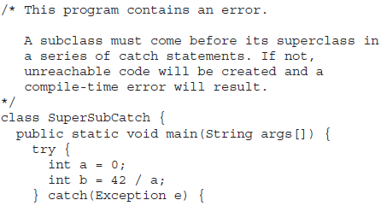
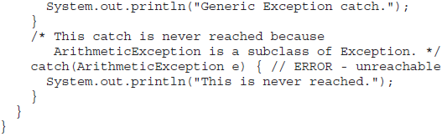
  Multiple catch Clauses: ...
Since ArithmeticException is a subclass of Exception, the first catch statement will handle all
Exception-based errors, including ArithmeticException. This means that the second catch statement will never execute.
To fix the problem, reverse the order of the catch statements.

Slide 31
  Nested try Statements:
A try statement can be inside the block of another try. Each time a try statement is entered, the context of that exception is pushed on the stack. If an inner try statement does not have a catch handler for a particular exception, the stack is unwound and the next try statement’s catch handlers are inspected for a match.
This continues until one of the catch statements succeeds, or until all of the nested try statements are exhausted. If no catch statement matches, then the Java run-time system will handle the exception.

Slide 32
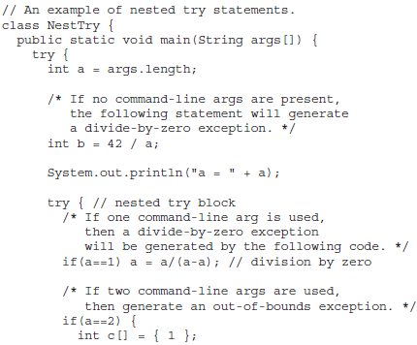
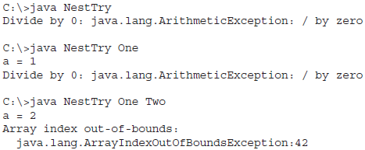
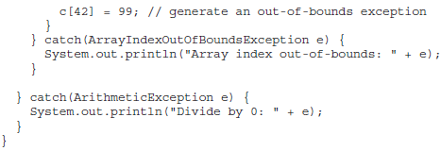
  Nested try Statements: ...

Slide 33
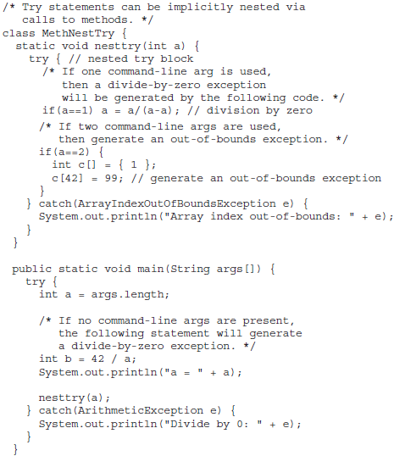
  Nested try Statements: ...
The output of this program is identical to that of the preceding example.

Slide 34
  throw:
So far, you have only been catching exceptions that are thrown by the Java run-time system. However, it is possible for your program to throw an exception explicitly, using the throw statement.
The general form: throw ThrowableInstance;
Here, ThrowableInstance must be an object of type Throwable or a subclass of Throwable. Primitive types, such as int or char, as well as non-Throwable classes, such as String and Object, cannot be used as exceptions.
There are two ways to obtain a Throwable object:
  using a parameter in a catch clause, or
  creating one with the new operator.

Slide 35
  throw: ...
The flow of execution stops immediately after the throw statement; any subsequent statements are not executed. The nearest enclosing try block is inspected to see if it has a catch statement that matches the type of exception.
If it does find a match, control is transferred to that statement. If not, then the next enclosing try statement is inspected, and so on.
If no matching catch is found, then the default exception handler halts the program and prints the stack trace.
Aa sample program that creates and throws an exception. The handler that catches the exception rethrows it to the outer handler.

Slide 36
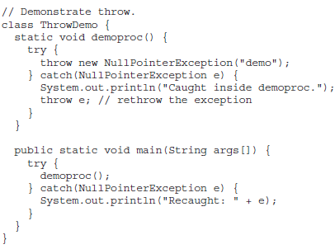
  throw: ...
The resulting output:
  Caught inside demoproc.
  Recaught: java.lang.NullPointerException: demo

Slide 37
  throw: ...
The program also illustrates how to create one of Java’s standard exception objects. Pay close attention to this line:
throw new NullPointerException("demo");
Here, new is used to construct an instance of NullPointerException. Many of Java’s builtin run-time exceptions have at least two constructors: one with no parameter and one that takes a string parameter.
When the second form is used, the argument specifies a string that describes the exception. This string is displayed when the object is used as an argument to print( ) or println( ). It can also be obtained by a call to getMessage( ), which is defined by Throwable.

Slide 38
  throws:
If a method is capable of causing an exception that it does not handle, it must specify this behavior so that callers of the method can guard themselves against that exception. By including a throws clause in the method’s declaration. A throws clause lists the types of exceptions that a method might throw. This is necessary for all exceptions, except those of type Error or RuntimeException, or any of their subclasses.
All other exceptions that a method can throw must be declared in the throws clause. If they are not, a compile-time error will result.

Slide 39
  throws:
The general form of a method declaration that includes a throws clause:
  type method-name(parameter-list) throws exception-list
  {
    // body of method
  }
  Here, exception-list is a comma-separated list of the exceptions that a method can throw.

Slide 40
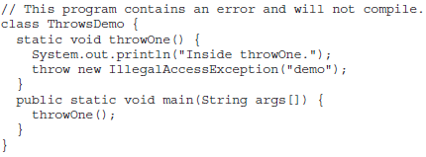
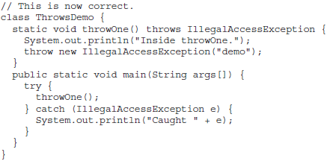
  throws: ...
An example of an incorrect program that tries to throw an exception that it does not catch. Because the program does not specify a throws clause to declare this fact, the program will not compile.
To make this example compile, you need to make two changes. First, you need to declare that throwOne( ) throws IllegalAccessException. Second, main( ) must define a try/catch
statement that catches this exception.

Slide 41
  finally:
When exceptions are thrown, execution in a method takes a rather abrupt, nonlinear path that alters the normal flow through the method.
Depending upon how the method is coded, it is even possible for an exception to cause the method to return prematurely. This could be a problem in some methods.
Eg: If a method opens a file upon entry and closes it upon exit, then you will not want the code that closes the file to be bypassed by the exception-handling mechanism. The finally keyword is designed to address this contingency.

Slide 42
  finally: ...
finally creates a block of code that will be executed after a try/catch block has completed and before the code following the try/catch block.
The finally block will execute whether or not an exception is thrown. If an exception is thrown, the finally block will execute even if no catch statement matches the exception.
Any time a method is about to return to the caller from inside a try/catch block, via an uncaught exception or an explicit return statement, the finally clause is also executed just before the method returns. This can be useful for closing file handles and freeing up any other resources that might have been allocated at the beginning of a method with the intent of disposing of them before returning. The finally clause is optional. However, each try statement requires at least one catch or a finally clause.

Slide 43
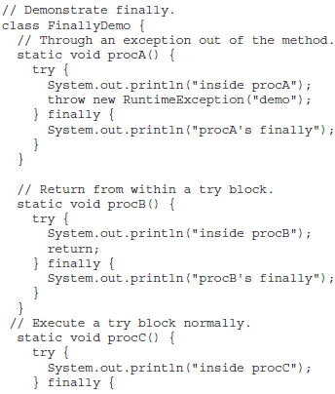
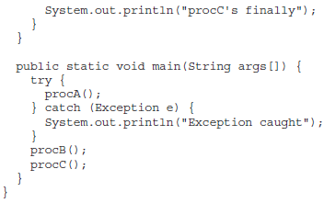
  finally: ...
In this example, procA( ) prematurely breaks out of the try by throwing an exception. The finally clause is executed on the way out. procB( )’s try statement is exited via a return statement.
The finally clause is executed before procB( ) returns. In procC( ), the try statement executes normally, without error. However, the finally block is still executed.
REMEMBER If a finally block is associated with a try, the finally block will be executed upon conclusion of the try.

Slide 44
  Java’s Built-in Exceptions:
Inside the standard package java.lang, Java defines several exception classes. A few have been used by the preceding examples. The most general of these exceptions are subclasses of the standard type RuntimeException. As previously explained, these exceptions need not be included in any method’s throws list. In the language of Java, these are called unchecked exceptions because the compiler does not check to see if a method handles or throws these exceptions.
The unchecked exceptions defined in java.lang are listed, lists those exceptions defined by java.lang that must be included in a method’s throws list if that method can generate one of these exceptions and does not handle it itself. These are called checked exceptions. Java defines several other types of exceptions that relate to its various class libraries.

Slide 45
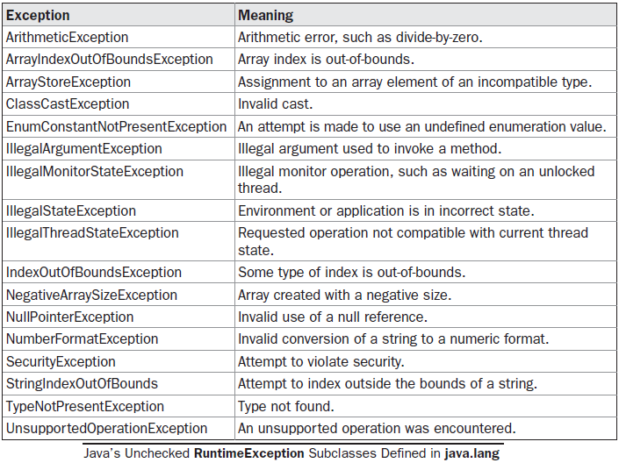
  Java’s Built-in Exceptions: ...

Slide 46
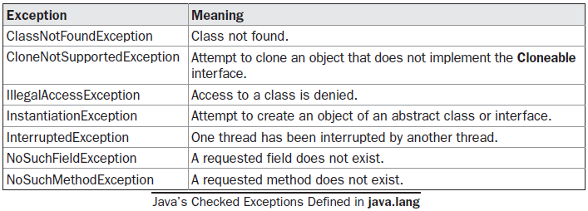
  Java’s Built-in Exceptions: ...

Slide 47
  Creating our Own Exception Subclasses:
A user defined exception should be a subclass of the exception class.
The Exception class does not define any methods of its own. It does, of course, inherit those methods provided by Throwable. Thus, all exceptions, including those that you create, have the methods defined by Throwable available to them.

Slide 48
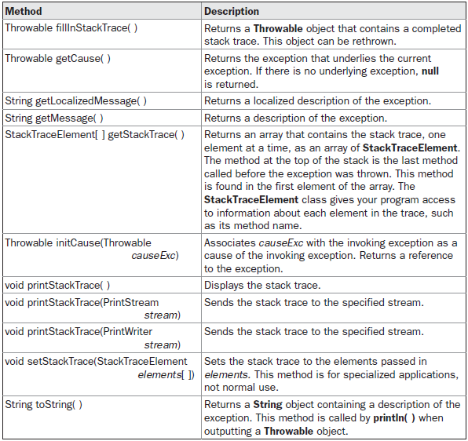
  Creating our Own Exception Subclasses: ...

Slide 49
  Using Exceptions:
Exception handling provides a powerful mechanism for controlling complex programs that have many dynamic run-time characteristics.
It is important to think of try, throw, and catch as clean ways to handle errors and unusual boundary conditions in our program’s logic.
Unlike some other languages in which error return codes are used to indicate failure, Java uses exceptions. Thus, when a method can fail, have it throw an exception. This is a cleaner way to handle failure modes.
One last point: Java’s exception-handling statements should not be considered a general mechanism for nonlocal branching.

